Slide 1


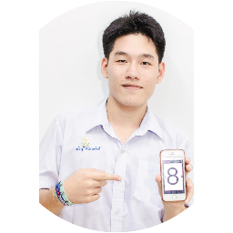

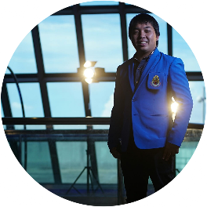
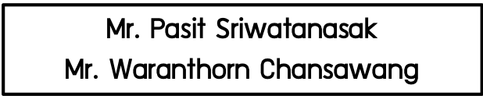
Thailand – Japan Student ICT Fair 2019
Artificial Cow Intelligent Milk
Problem Statement
Nowaday, There are problems in our education system. For example, the slow developmental children groups are becoming more in society so, we would like to solve the problem by AI technology or based on computer knowledge. We use the SWOT to analyze the best solution, finally color theory and python program are capable of solving this statement.
Mr. Pasit Sriwatanasak
$$\text{Mr}\text{. }\text{Waranthorn} \text{Chansawang}$$
Advisor : Mr. Khunthong Klaythong

Slide 2
Problem Statement
Nowaday, There are problems in our education system. For example, the slow developmental children groups are becoming more in society so, we would like to solve the problem by AI technology or based on computer knowledge. We use the SWOT to analyze the best solution, finally color theory and python program are capable of solving this statement.
Overview
“Innovative
draft
Design”
1
SWOT analysis
Strength
Weaknesses
Opportunity
Threat
2
“The best solution”
Color theory
Python programing language
Ball+Cow simulation
Create
2

Slide 3






Innovation process
1
Investigate
ADHD is a current problem in childhood
2
SWOT analysis
Thinking of 4 models
3
The best solution
Choose the best way
Create
Create the innovation from design ,modal
4
5
Test
Test the innovation
6
Improve
Improve the mistake by practical use
3

Slide 4
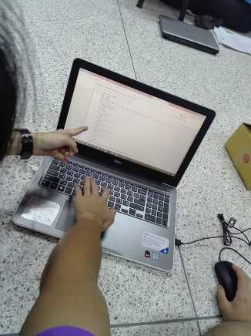
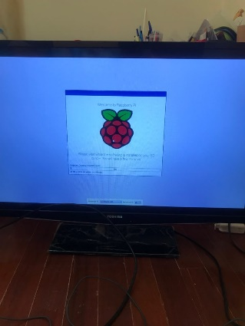
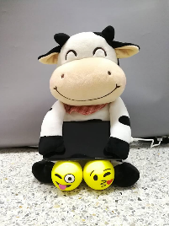
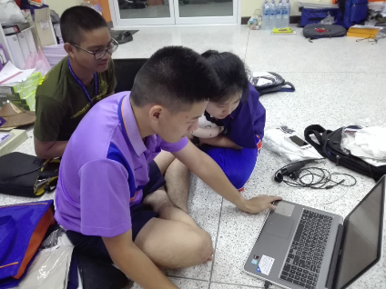
Material and Equipment
Computer
Manage all thing in this project
Doll
Appeal children
Python
Implement code and test
Raspberry Pi
Single-board computers
4

Slide 5
Material and Equipment
Flex Sensor
Manage all thing in this project
Ball
Squeeze to play game
Monitor
Display game
HDMI Cable
Connect Raspberry Pi to monitor
5

Slide 6
Process
1. Learning basic of Python.
2. Learning how to use Pygame.
3. Make Colored Circle and Colored Text.
4. Implement code and test.
5. Git Push

Slide 7
Process
5. Learn how to use Raspberry Pi.
6. Clone repository to Raspberry Pi.
7. Run in Raspberry Pi.
8. Connect to Monitor.

Slide 8

Process
9. Attach the flex sensor to the ball.
10. Connect ball to Raspberry Pi
11. Attach everything on Cow doll.

Slide 9
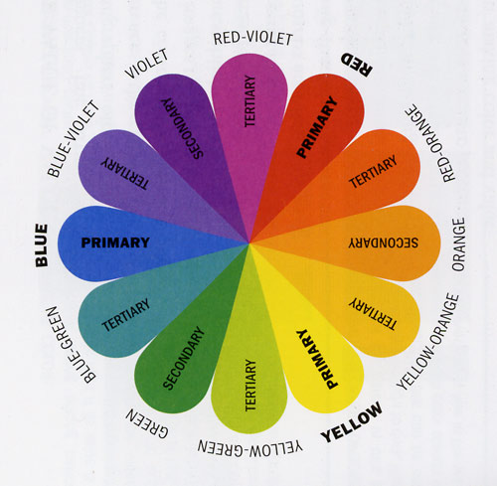
Steps for using innovation
Learn the color theory
Ex
RED
BLUE
VIOLET
The name of the first color
match the second color
(opposite color)
: Regardless of the color
of the first color name
9

Slide 10
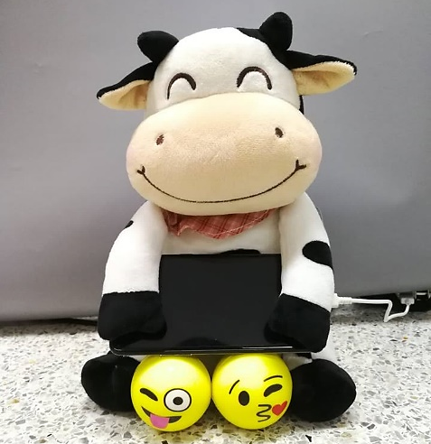
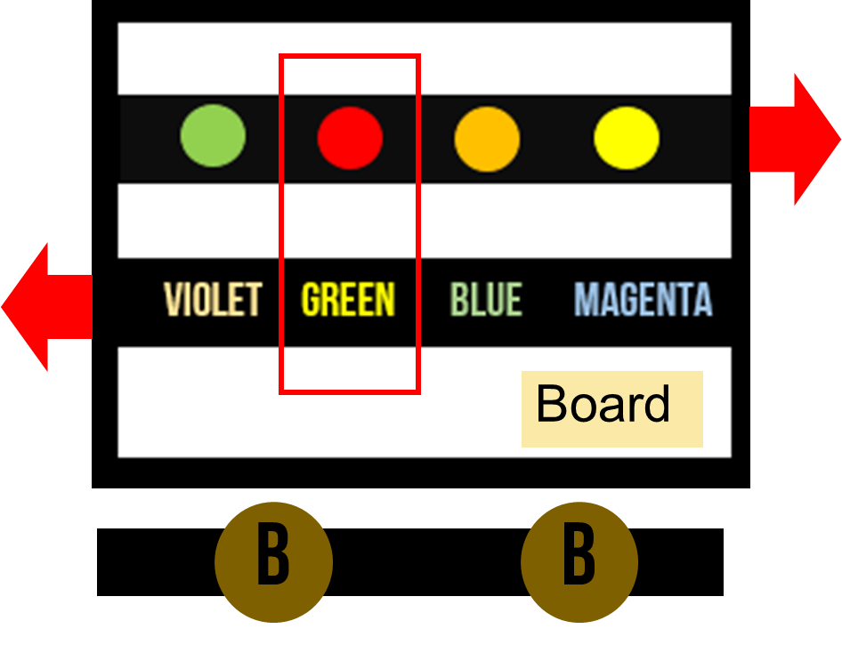
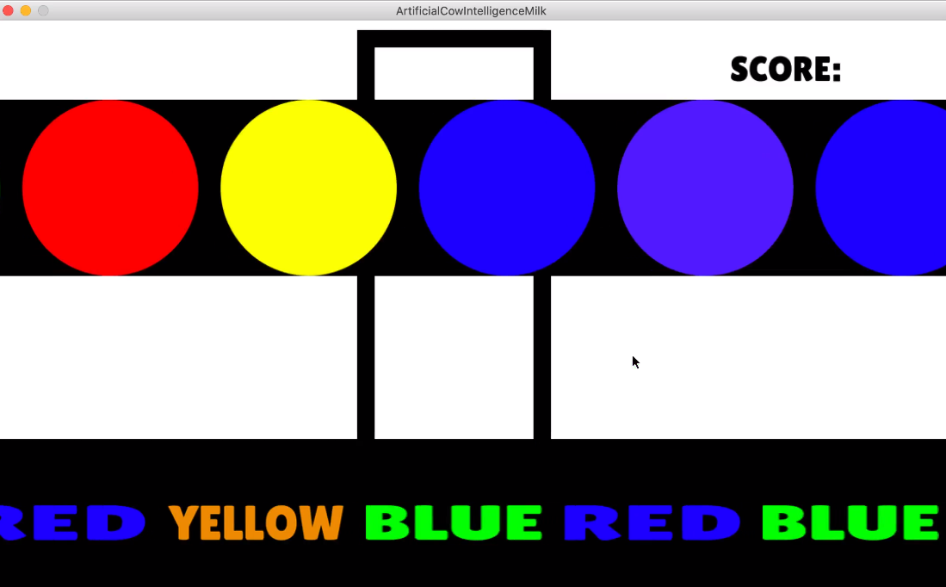
Steps for using innovation
The first color bar moves to the right
Message bar moves to the left
Message bar moves to the left and Push button
Push button
10

Slide 11
Innovation prototype
Cow doll
Raspberry Pi
Appeal children
Single-board computers
Monitor
To display game
Ball for squeezing
Squeeze to play game
11

Slide 12
THANK YOU
Q&A

Slide 13
Thailand – Japan Student ICT Fair 2019
Artificial Cow Intelligent Milk
Problem Statement
Nowaday, There are problems in our education system. For example, the slow developmental children groups are becoming more in society so, we would like to solve the problem by AI technology or based on computer knowledge. We use the SWOT to analyze the best solution, finally color theory and python program are capable of solving this statement.
Mr. Pasit Sriwatanasak
$$\text{Mr}\text{. }\text{Waranthorn} \text{Chansawang}$$
Advisor: Mr. Khunthong Klaythong

